Slide 1
Deep learning

Slide 2
Multi-layer Perceptron network
Training a MLP: forwards (working out what the outputs are for the given inputs based on the current weights) and backwards (updating the weights according to the error, which is a function of the difference between the outputs and the targets).
Back-propagation of error: SSE
Activating function: the sigmoid function
Universal Approximation Theorem: an NN with a single hidden layer can represent a wide variety of interesting functions when given appropriate parameters, and thus can learn perfectly any classification problem.

Slide 3
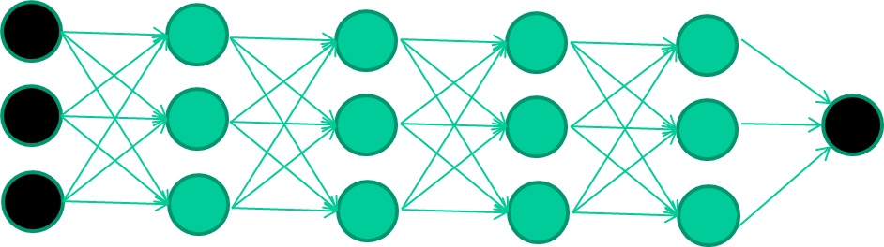
Deep Learning using multiple layers neural networks
Many-layer neural network architectures are capable of learning the true underlying features and ‘feature logic’, and therefore generalize very well …

Slide 4
However, no efficient algorithm available to learn multi-layer NNs until recently

Slide 5
The new way to train multi-layer NNs…
Train this layer first

Slide 6
The new way to train multi-layer NNs…
Train this layer first
then this layer

Slide 7
The new way to train multi-layer NNs…
Train this layer first
then this layer
then this layer

Slide 8
The new way to train multi-layer NNs…
Train this layer first
then this layer
then this layer
then this layer

Slide 9
The new way to train multi-layer NNs…
Train this layer first
then this layer
then this layer
then this layer
finally this layer

Slide 10
The new way to train multi-layer NNs…
EACH of the (non-output) layers is trained to be an auto-encoder
To learn good features that describe what comes from the previous layer

Slide 11
Auto-encoder (Auto-Associative Network)
An auto-encoder is trained, with a standard weight-adjustment algorithm to reproduce the input (for compression of data).
It captures the essential underlining features/structures of the data.

Slide 12
Iterate the learning, but randomize the order of the input vectors so that you don’t train in exactly the same order each iteration. Recall using the forwards phase algorithm.

Slide 13
Intermediate layers are each trained to be auto-encoders (or similar)
By making this happen with (many) fewer units than the inputs, this forces the ‘hidden layer’ units to become good feature detectors

Slide 14
Final layer trained to predict class based on outputs from previous layers
Except the final layer, the training of the middle layers are NOT dependent on the desirable output of training data. The auto-encoder is similar to un-supervised learning of the feature vectors.

Slide 15
Deep Learning: Advantages
Features automatically extracted and tuned for the desirable output
No feature engineering (often tricky) needed
Robustness to variations automatically learned
Reusable: the same network structure can be used for many applications and data types
Scalable to large volume of training data
Assisted with hardware acceleration like GPUs
Perfect companion with Big Data

Slide 16
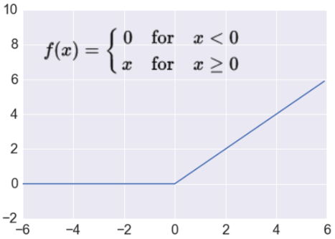
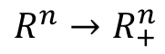
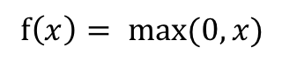
Activation Function for DL: rectified linear unit (ReLU)
Most Deep Networks use ReLU as the activation function
Trains much faster
accelerates the convergence
due to linear, non-saturating form
Less expensive operations
compared to sigmoid/tanh (exponentials etc.)
implemented by simply thresholding a matrix at zero
More expressive
http://adilmoujahid.com/images/activation.png
Takes a real-valued number and thresholds it at zero
$$f\left(x\right)= max⁡(0,x)$$
$$R^{n}→R_{+}^{n}$$
Notes:
ReLU units can “die”
large gradient flowing through a ReLU could cause weights to update in such a way that the neuron will never activate on any datapoint again
gradient flowing through the unit will forever be zero from that point on
With a proper setting of the learning rate this is less frequently an issue

Slide 17
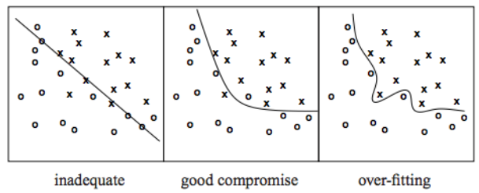
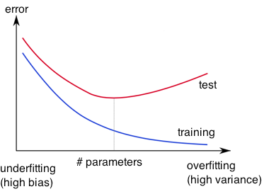
Overfitting
http://wiki.bethanycrane.com/overfitting-of-data
Learned hypothesis may fit the training data very well, even for outliers (noise) but fail to generalize to new examples (test data)
https://www.neuraldesigner.com/images/learning/selection_error.svg

Slide 18
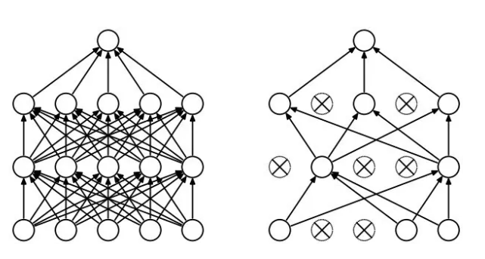
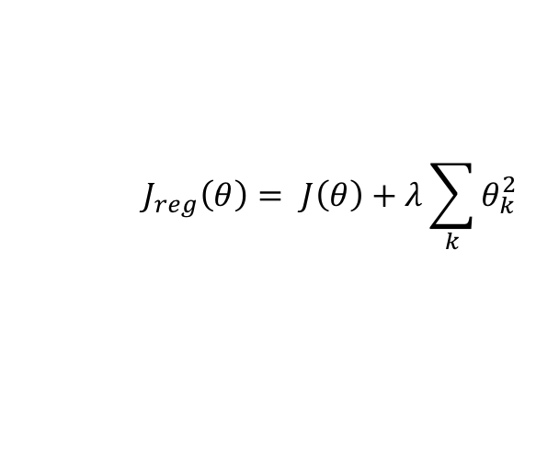
Regularization
Dropout
Randomly drop units (along with their connections) during training
Each unit retained with fixed probability p, independent of other units
Hyper-parameter p to be chosen (tuned)
Srivastava, Nitish, et al. "Dropout: a simple way to prevent neural networks from overfitting." Journal of machine learning research (2014)
Penalization
Regularization term that penalizes big weights, added to the objective function
Weight decay 𝛌 determines the impact of regularization term during training
big 𝛌 → big penalty for big weights
$$J_{reg}\left(θ\right)= J\left(θ\right)+λ\sum_{k}{θ_{k}^{2}}$$
Early-stopping
Use validation error to decide when to stop training
Stop when the error has not reduced after n subsequent epochs
n: patience

Slide 19
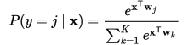

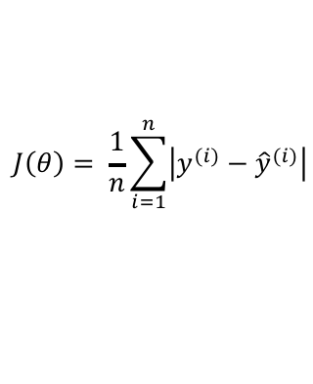
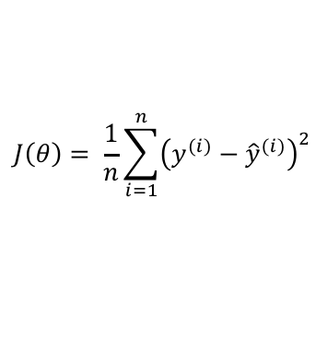
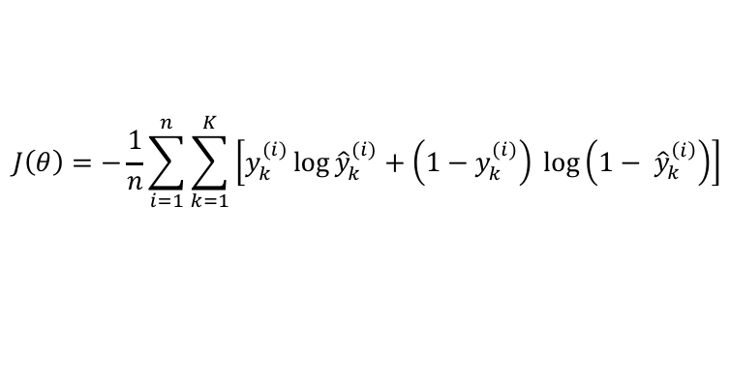
Cost functions and output
Classification
Regression
Training
examples
R^{n} x {class_1, ..., class_m}
(one-hot encoding)
R^{n} x R^{m}
n inputs, m outputs
Output
Layer
Soft-max
[map R^{n} to a probability distribution]
Linear (Identity) or Sigmoid
f(x)=x
Cost
function
Cross-entropy
$$J\left(θ\right)= \frac{1}{n}\sum_{i=1}^{n}{{\left(y^{(i)}−{\hat{y}}^{(i)}\right)}^{2}}$$
SSE
$$J\left(θ\right)=−\frac{1}{n}\sum_{i=1}^{n}{\sum_{k=1}^{K}{\left[y_{k}^{(i)}\log{{\hat{y}}_{k}^{(i)}+\left(1−y_{k}^{(i)}\right) }\log\left(1− {\hat{y}}_{k}^{\left(i\right)}\right)\right]}}$$
Mean Absolute Error
$$J\left(θ\right)= \frac{1}{n}\sum_{i=1}^{n}{\left|y^{(i)}−{\hat{y}}^{(i)}\right|}$$
Many other cost functions.
Notes:
Exponentiate to make it positive
MSE has nice mathematical properties which makes it easier to compute the gradient
Because of the square, large errors have relatively greater influence on MSE.
Therefore, MAE is more robust to outliers since it does not make use of square.

Slide 20
Convolutional Neural Networks (CNNs)
https://www.mdpi.com/entropy/entropy-19-00242/article_deploy/html/images/entropy-19-00242-g001.png
Main CNN idea: Compute vectors of snapshots (convolution) and group them afterwards (pooling)

Slide 21
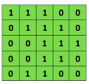

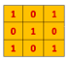
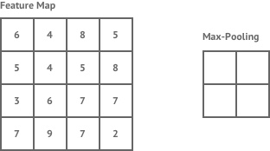
Convolutional Neural Networks (CNNs)
Convolution
Convolutional
3x3 filter
Input matrix
http://deeplearning.stanford.edu/wiki/index.php/Feature_extraction_using_convolution
Pooling
https://shafeentejani.github.io/assets/images/pooling.gif

Slide 22
Recurrent Neural Networks (RNNs)
RNN has a short-term memory: it has two inputs, the present and the recent past.
It is important for sequential data (e.g., time series or natural language sentences) where the sequence of data contains crucial information about what is coming next.
Training using Backpropagation Through Time (BPTT): the error is back-propagated from the last to the first timestep for each timestep and the weights is updated accordingly. Expensive there are a large number of timesteps.

Slide 23
More on Deep Learning
Generative models
GANs & Adversarial training
Bayesian Deep Learning
DL for unsupervised learning
Graphical Neural Network (GNN)
To learn more on deep learning:
Deep Learning Specialization on Coursera: https://www.coursera.org/specializations/deep-learning

